Slide 1


The Unraveling of Aamir Liaquat Hussain: A Cautionary Tale of Mental Health inthe Workplace

Slide 2


Bipolar Disorder
Bipolar disorder,also known as manic-depressive illness,is a mental health condition that causes extreme shifts in mood, energy,and activity levels.
Individuals with bipolar disorder experience episodes of mania or hypomania (elevated mood) and depression.

Slide 3

Manic and Depressive Episodes in Bipolar Disorder
Manic episodes are a defining feature of bipolar disorder. These episodes are characterized by high energy,decreased need for sleep, grandiosity,racing thoughts, and impulsivity. During manic episodes, individuals may engage in risky behaviors such as excessive spending or substance abuse. They may also exhibit irritability, agitation, and even psychosis. On the other hand, depressive episodes are marked by low mood, fatigue, feelings of worthlessness, and difficulty concentrating. Individuals with bipolar disorder may
experience suicidal ideation during depressive episodes.
The frequency and severity of manic and depressive episodes vary among individuals with bipolar disorder. Some individuals may experience more frequent and severe episodes, while others may have long periods of stability between episodes. Treatment for bipolar disorder typically involves medication, therapy, and lifestyle changes to manage symptoms and prevent relapse.

Slide 4
Introduction
The Incident
Hussain's History
Criticism by Memers
Mental Health inthe Workplace
Consequences and Accountability
Conclusion

Slide 5

Introduction
Aamir Liaquat Hussain,a well-known television personality and politician,made headlines inJune 2021 for his involvement in a violent altercation with a journalist during a live broadcast of his political talk show on a private news channel.
The incident,which was caught on camera and quickly went viral,sparked widespread outrage and condemnation,bringingto light Hussain's history of erratic behavior and allegations of verbal abuse and harassment toward colleagues and subordinates.
x
Share

Slide 6

Aamir Liaquat Hussain was criticized by memers
In addition to facing criticism from the media and public figures,Aamir Liaquat Hussain has also beenthe subject of ridicule and mockery by internet memes.
These memes often highlight his controversial statements and actions, as well as his perceived arrogance and lack of professionalism.
While some may argue that these memes are harmless and simply a form of satire,others believe that they contribute to a toxic workenvironment for Hussain and his colleagues.Furthermore,they can exacerbate existing mental health issues and lead to further stigmatization of individuals struggling with mental illness inthe workplace.

Slide 7
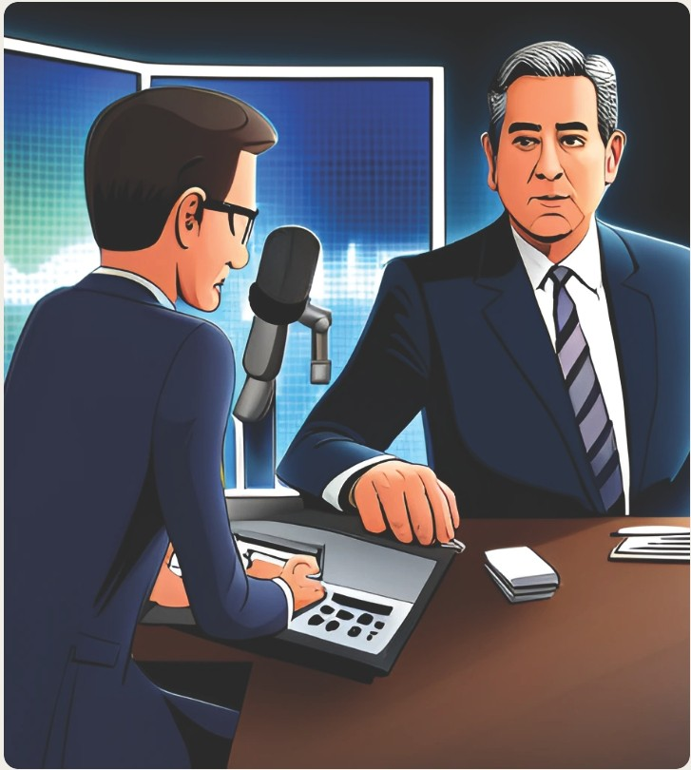
The Incident
Duringthe live broadcast,the journalist criticized Hussain on social media, prompting him to become enraged and physically assault thejournalist on air.
The incident caused an uproar on social media and led to calls for Hussain to be held accountable for his actions.

Slide 8

Hussain's History
Following the incident,it was revealed that Hussain had a
history of erratic behavior and had
been diagnosed with bipolar disorder.
He had also faced several allegations of verbalabuse and harassment towards colleagues and subordinates inthe past, raising questions about the
culture and accountability within the media industry.

Slide 9

Mental Health inthe Workplace
The case highlighted the
importance of addressing mental health issues in the workplace and providing adequate support and resources for individuals who may be struggling with
psychological problems.
It also brought attention to the need for bettertraining and education around workplace conduct and respectful communication,particularly in
high-pressure environments like the media industry.

Slide 10
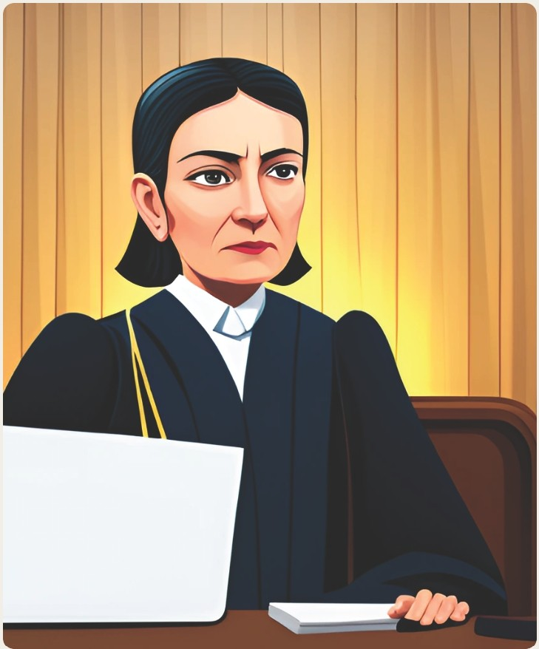
Share
••• X
Consequences and
Accountability
Inthe aftermath of the incident, Hussain facedwidespread criticism and calls for himto be held accountable for his actions.
Hewas subsequently suspended from his position as host of the talkshow and faced legal action from the journalist he had assaulted,highlighting the
importance of consequences and accountability for workplace misconduct.

Slide 11

Aamir's Tragic
Death
After the incident,Aamir Liaquat Hussain's mental health continued to deteriorate.He struggled with depression and anxiety,and his career suffered as a result.Unfortunately,things took a turn for the worse when hewas found dead in his home.The cause of death was ruled a suicide,which shocked many who knew him.
The tragic end to Aamir's life serves as a stark reminder of the importance of addressing mental health inthe workplace.It highlights the needfor employers to provide support and resources for employees struggling with mental health issues, and for society as a wholeto reducethe stigma surrounding mental illness.

Slide 12
Conclusion
ii-
911
--
The case of Aamir Liaquat Hussain serves as a cautionary tale about the dangers of unchecked power and the
importance of creating safe and supportive work environments for all employees.
It also underscores the need for increased awareness and understanding of mental health
issues andthe role they can play in workplace dynamics and behavior.

